Slide 1
Cohort 4 Data Analysis & Insights
By Faith Maina

Slide 2
Introduction
Goal: Analyze the Cohort 4 dataset to:
Understand participant demographics and performance
Identify factors influencing graduation rates
Recommend actions to improve future mentorship cohorts
Tools used: Excel, SQL-LITE, and Power BI

Slide 3
Data Cleaning & Methodology
No duplicates found in participant IDs
Standardized track names using TRIM & PROPER
Encoded experience ranges into numeric months (3 to 42)
Converted learning hours into numeric values (3, 10, 16)
Converted Yes/No to Boolean (1/0) for aptitude & graduation

Slide 4
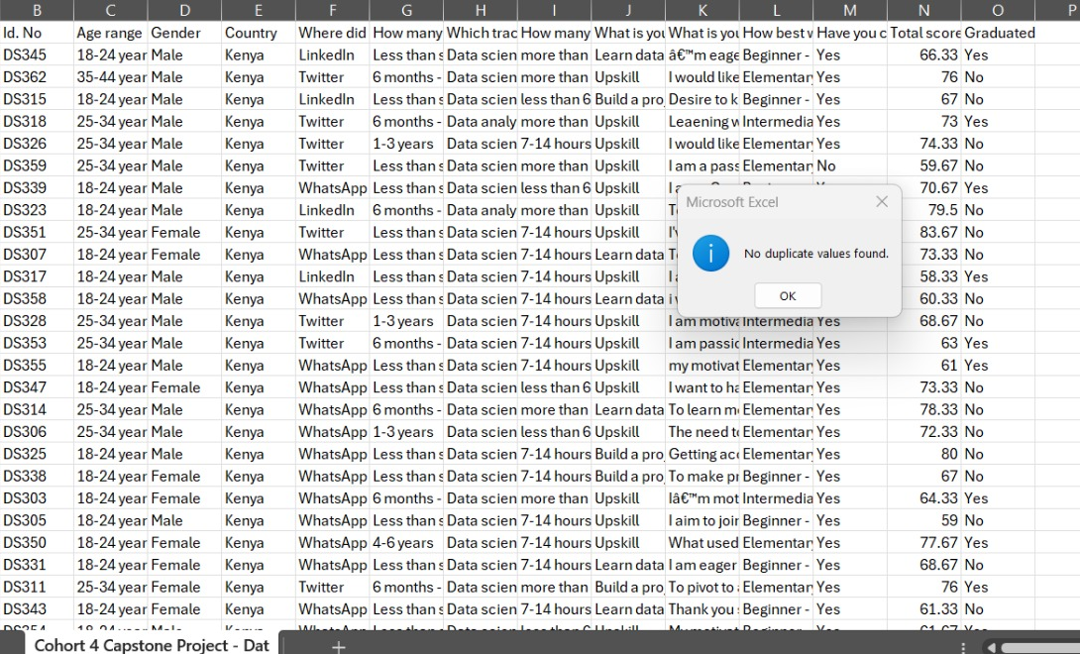
1) No duplicates found in participant IDs

Slide 5
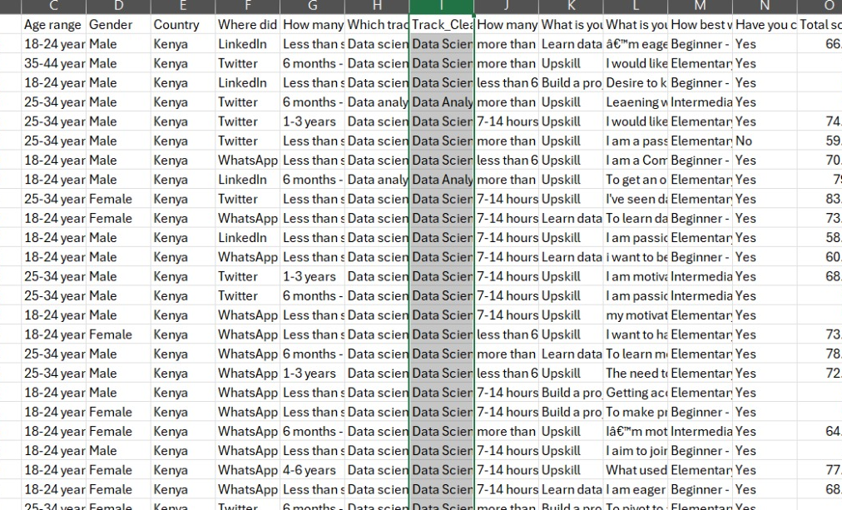
2) Standardized track names using Excel (TRIM & PROPER functions).

Slide 6
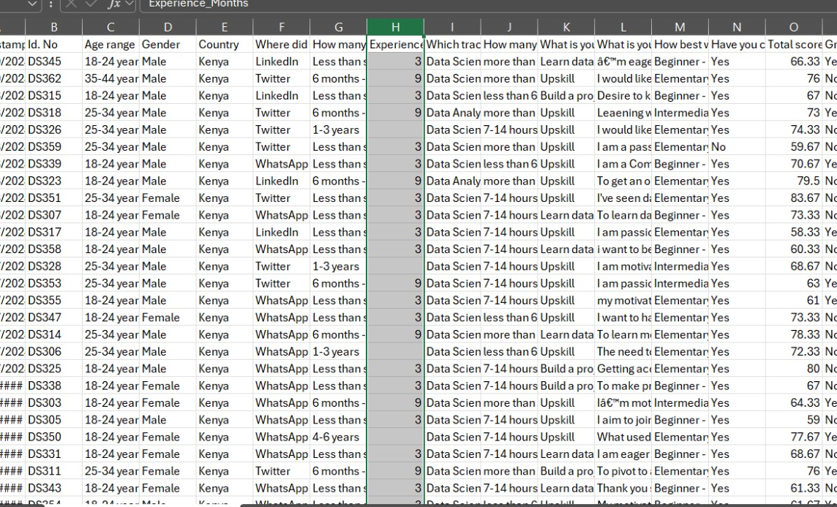
3) Encoded experience ranges into numeric months for analysis.

Slide 7
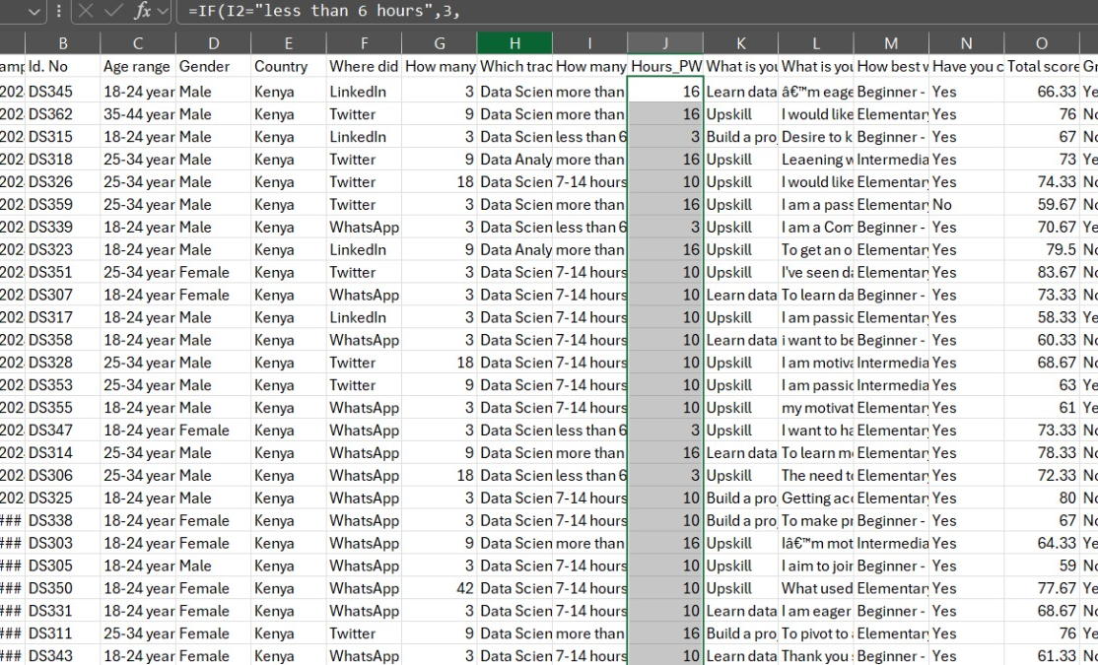
4) Converted weekly learning hours into numeric values (3, 10, 16)

Slide 8
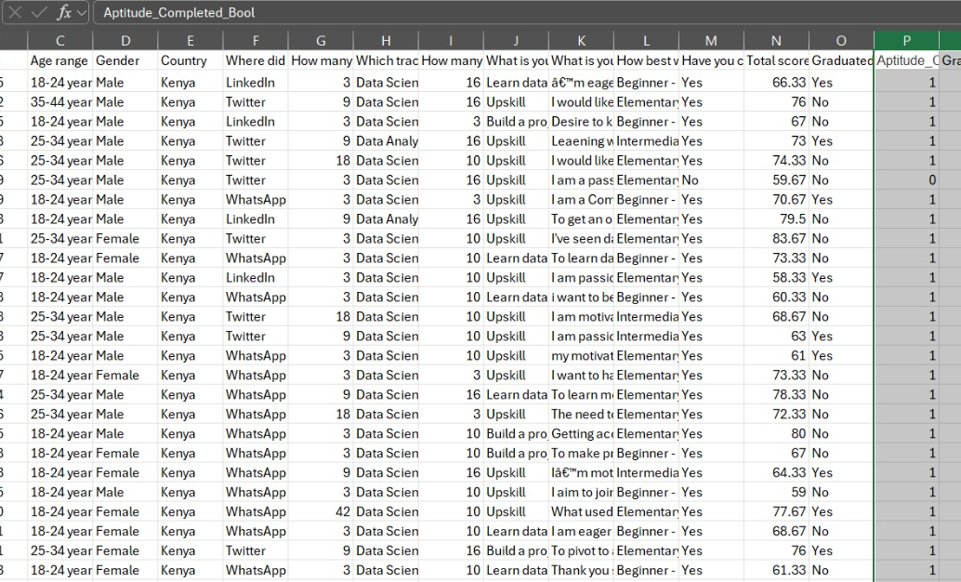
5) Converted Yes/No responses into Boolean values (1/0).

Slide 9
Key SQL Analysis Findings
Data quality confirmed (clean total_score, no nulls)
Track performance analysis with graduation rates
Top countries identified → global participant base
Age & gender demographics analyzed
Insights into completion rates and success factors

Slide 10
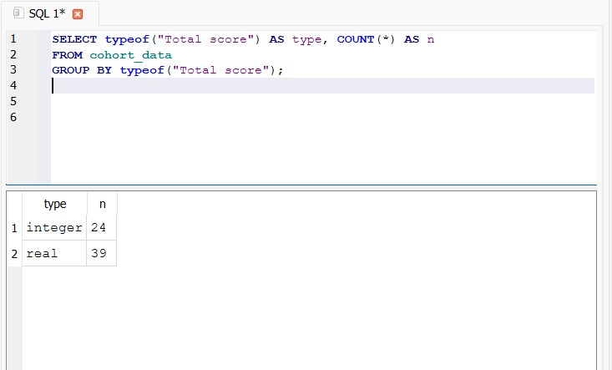
1) check whether total score is numeric or text

Slide 11
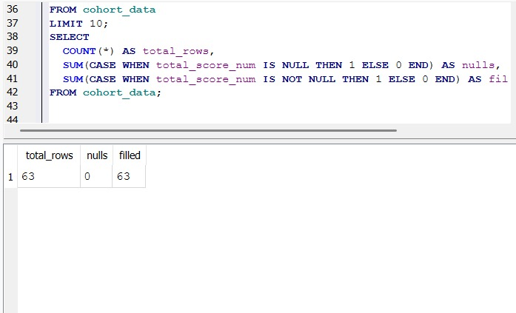
2) now there are no nulls in total score

Slide 12
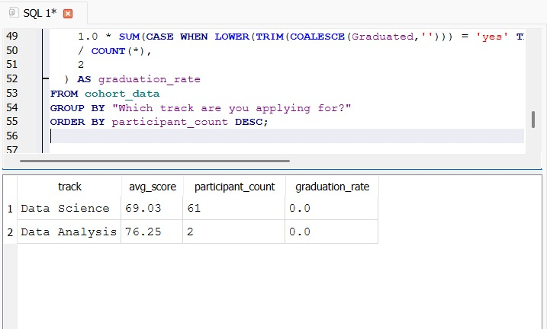
3) Average score by track + count + graduation rate

Slide 13
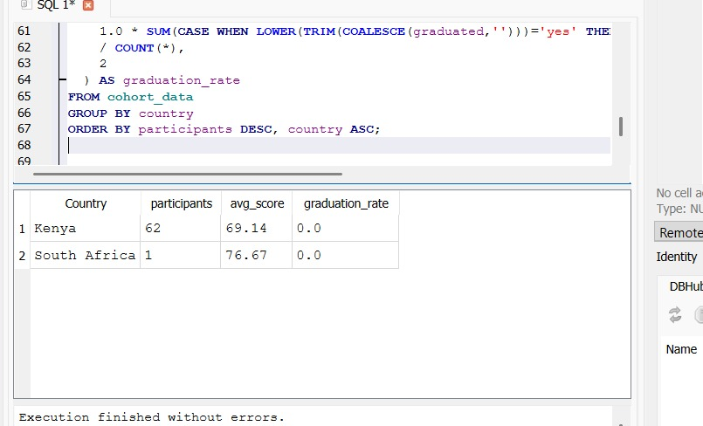
4) Top countries represented

Slide 14
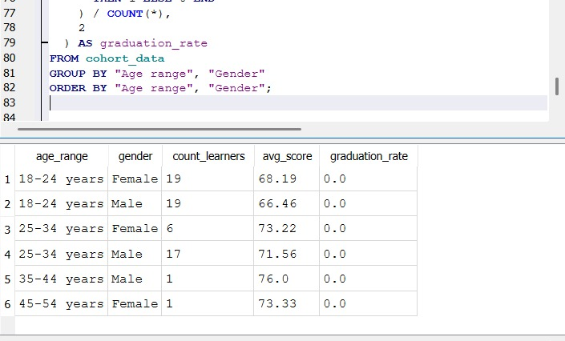
5) Demographics — age by gender

Slide 15
Power BI Dashboard
Dynamic demographic breakdowns (age, gender, country)
Track distribution → program popularity
Correlation charts: learning hours, experience, scores
Graduation trend analysis

Slide 16
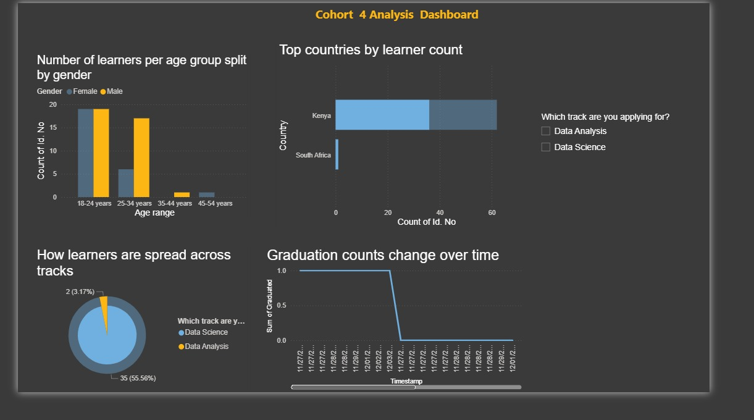

Slide 17
Conclusions & Recommendations
Experience, learning hours, and track choice affect success
Data cleaning enabled accurate statistical analysis
Power BI dashboard aids program optimization
Recommendations:
- Guide student placement
- Adjust program structures
- Identify at-risk participants early

Slide 18
Questions & Answers

